Slide 1
DMD Management
Nadia Merchant, MD
Assistant Professor of Pediatrics
Pediatric Endocrinologist and Geneticist

Slide 2
Disclosures
Growth Advisory Board for BioMarin, Pfizer and Alexion
No relevant financial disclosures for this presentation

Slide 3
Management of DMD is Multidisciplinary
Diagnostics
PT & Rehabilitation management
Corticosteroid management
Management should be provided bu a patient-oriented mulidisciplinary team
Realistic therapeutic plan should be established with the patient and his family
Patient should be assessed every 6 monhs and get full assesment every year
Access to first line care should be organised.
Prevention of disese next milestone should always be prioritized
Patient
Pulmonary management
GI, swallowing, nutrition management
Psychological management
Cardiac management
Bone Health
Endocrine Management

Slide 4
Why corticosteroids?
Suggestion for LS: add a SOC slide ahead of this one and complete with the clip from webcast
Management of DMD is Multidisciplinary
Neurology
Corticosteroid management
Prednisone, Deflazacort, Vamorolone
Exon skipping
Gene therapy
Diagnostics
Delayed loss of ambulation
Preserved upper limb function
Reduced scoliosis surgery
Improved cardiopulmonary function
PT & Rehabilitation management
DMD
Pulmonary management
GI, swallowing, nutrition management
All or most new treatments are used or investigated in combination with corticosteroids
Psychological management
Cardiac management
Bone Health
Endocrine Management

Slide 5
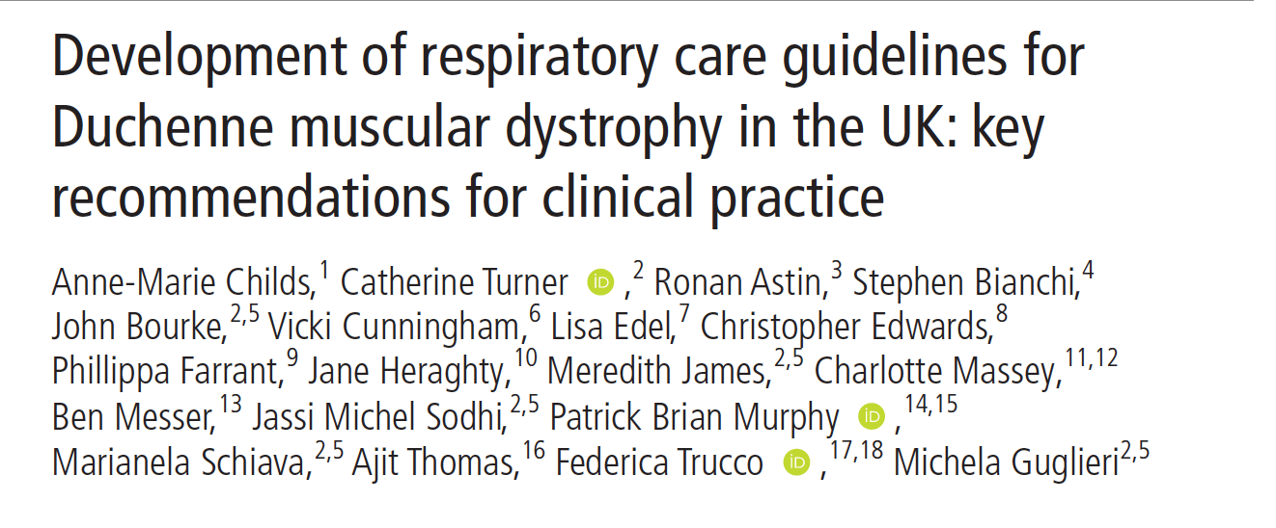
Respiratory management
Most issues happen after loss of ambulation- although prevention and management should start before
Key mechanisms
Alveolar hypoventilation
Cough insufficiency
Risk of aspiration (bulbar weakness- cough insufficiency)
Risk of infection (steroids- aspiration-cough insufficiency-atelectasia)
Risk of atelectasia (infection- hypoventilation
Prevention
Chronic Management
Acute management

Slide 6
Prevention & Chronic Management
Vaccination : Full vaccination (except live vaccine if on steroids) + Pneumo23+Influenza+Covid19
Monitoring of pulmonary function (PFE) and nucturnal ventilation (sleep studies with pCO2 measure)
Initiation of nocturnal BPAP when needed
Chest physiotherapy :
Cough : Manually assisted cough
Inspiration ; Lung Volume recruitment- Breath Stacking
Expiration : Mechanical insuflation-exsuflation devices
Put in place a plan for acute care and discuss limit of care (intubation…)

Slide 7
Acute Management
Empirical Antibiotic treatment
Manual assisted cough and Mechanical insuflation-exsuflation device
Non invasive ventilation with BPAP- and adjusting the pressure
Monitoring of pC02
Avoiding passive Oxygen
Cardiac-digesgtive-endocrine management
If atelectasia- consider the need of bronchoscopy
If not sufficient- consider intubation

Slide 8
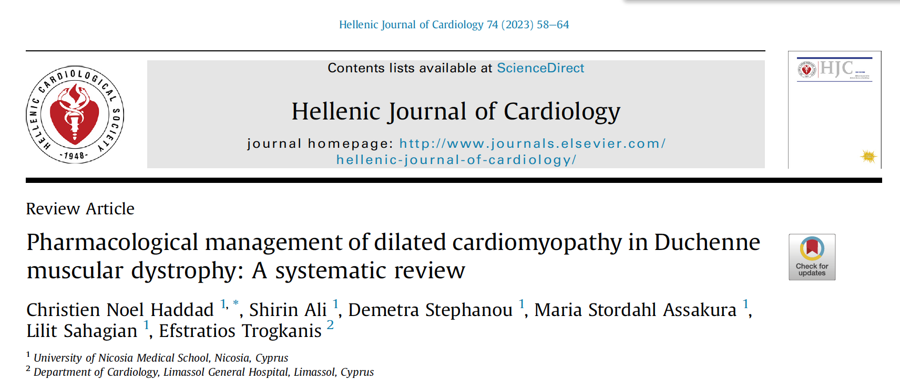





Cardiac management
Annual assesment through heart ultrasound in infants- cardiac MRI in teenagers + EEG
ACE-Inhibitors at the age of 8-10 year. Ex : Captopril 2.5 mg
If not well tolerated : consider Losartan
Eplerenone or Spironolactone 50 pg daily
In case of mild to moderate dysfunction : Beta-blocker (ex : carvedilol)
Sacubitril/Vasartran can be an option in severe case

Slide 9
Steroids- which one- how much-when….
Starting before the age of 5 years (but when exactly ?) is more efficient
Dose between 0.3-0.9 mg/kg with some evidence of dose effect
Superiority of Deflazacort on Prednisone is controversial- some evidence points to a better efficacy- some not.
Different regimen exist: Daily dose One day on-One day off 10 days on-10 days off….
Daily dose seems more efficient but associated with more side effects.

Slide 10
Steroids in my practice
Start around the age of 3- when vaccination is completed (Chicken pox !)
Explain the importance of healthy diet before starting- and ideally around diagnostic
Start slowly with 1mg of DFZ to increase every 5 days- up to 0.9mg/Kg
If the patient presents with behavioural issue- stop increasing and keep with the highest well-tolerated dose. Try to increase again slowly three months later
Keep with daily dose if well-tolerated. Consider one day on/one day off if unmanageable side effect- or when growth delay become an issue

Slide 11
Orthopaedic management
Prevention of contracture : exercise/stretching/Splints…
Surgery of contracures are rarely indicated (only if significant functional benefit to be expected)
In case of fracture- prioritze fixation and mobilisation when possible rahter than long casting immobilization
Scoliosis surgery when Cobb angle > 40 and Vital capacity > 40%

Slide 12
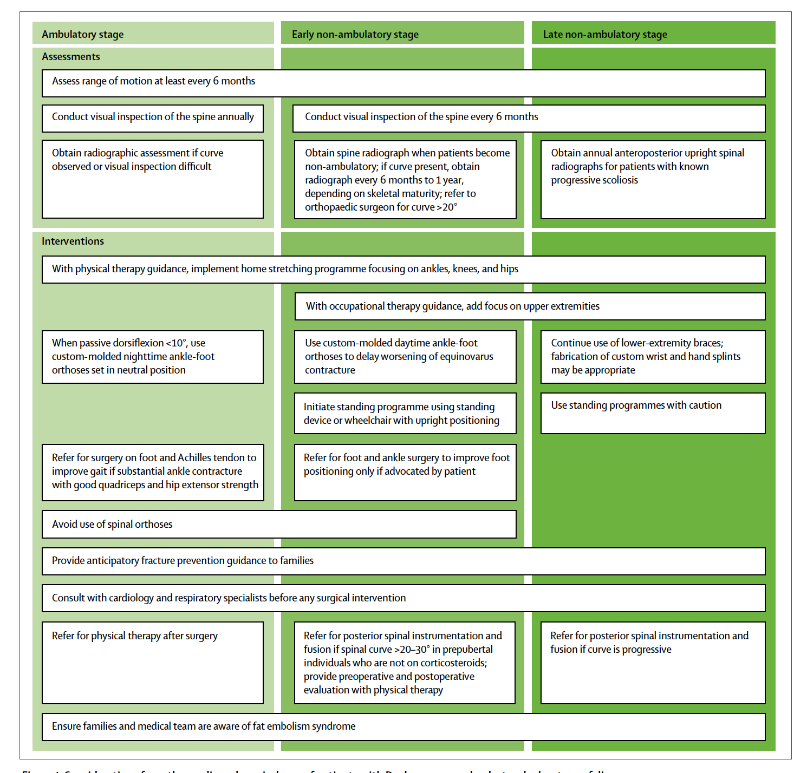

Slide 13

We all play a role in maximizing bone health and quality of life!
Suggestion for LS: to create an orthopaedic slide to add after this one
Alba to use the reference to create descriptive text for this slide
Hormones/
Puberty
Chronic
Disease = DMD
Steroids
Physical Activity
(Mechanosensors in bone for bone modeling and remodeling)
Nutrition and Diet
(Vitamin D/Calcium)

Slide 14
Monitoring Side Effects of Glucocorticoid Treatment: Refer to endocrine
Alba to use the reference to create descriptive text for this slide and complete with clip from webcast
Bone Health/Risk for Osteoporosis:
DXA scan annually along with spine assessment for fractures
Calcium and vitamin D intake/supplement, monitoring labs when appropriate
Vitamin D Level (goal >30 ng/dL)
Puberty/Risk for Delayed/Arrested Puberty
Monitor for puberty delay
Consider starting testosterone, important for bone health
Testosterone replacement for all boys > 14 with confirmed hypogonadism, can be considered starting as early as 12 years.
Evaluate with bone age, LH, FSH, testosterone
Gradually increase testosterone
Adrenal Insufficiency:
Due to taking chronic steroids, risk for adrenal insufficiency
Need a sick day plan along with emergency steroids
Weight Management
Nutrition
Metabolic screening
Hyperglycemia: History: polyuria, polydipsia, dietary history. Annual random blood glucose and A1C
Hypertension: Blood pressure should be monitored at each clinic visit (at least every 6 months)
Dyslipidemia: Lipid panel annually
Weight gain with steroids
Obstructive sleep apnea symptoms and evaluation as recommended
Growth/Risk for Impaired Growth:
Monitor growth
Evaluate when appropriate for other causes of impaired growth (CBC, CMP, celiac, thyroid)
Growth hormone is not recommended, can be considered case by case

Slide 15
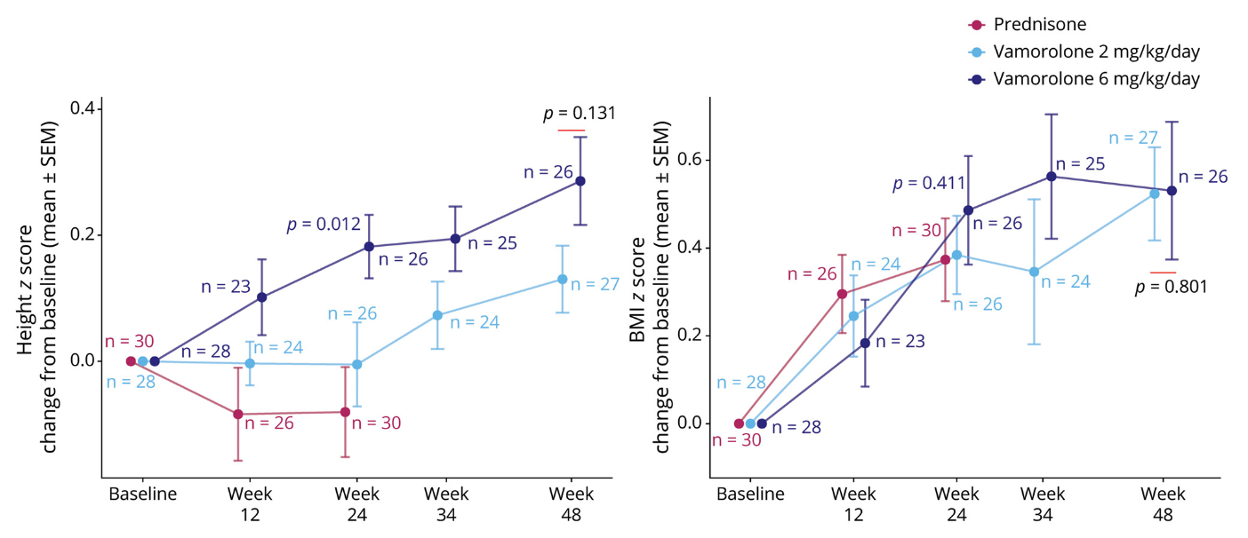
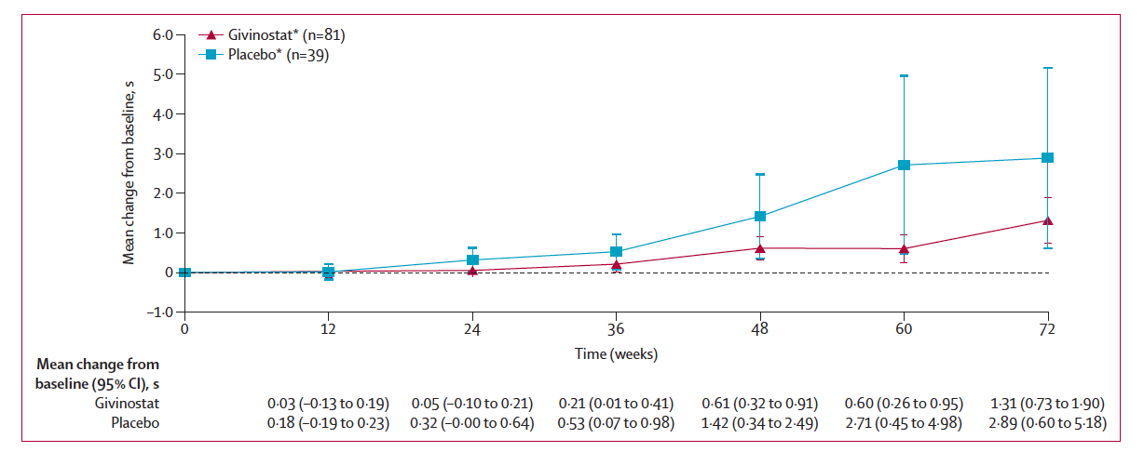
New therapies and potential improvement
Vamorolone has the potential to achieve a similar efficacy than prednisone with less adverse event
Givinostat can slow down the decline of ambulation in patients older than 6 years
The effect of AAV-microdystrophin gene therapy is still unclear but could slightly improve motor function in 4-7 year old kid

Slide 16
Ward LM, Weber DR. Growth, pubertal development, and skeletal health in boys with Duchenne Muscular Dystrophy. Curr Opin Endocrinol Diabetes Obes. 2019 Feb;26(1):39-48. doi: 10.1097/MED.0000000000000456. PMID: 30507696; PMCID: PMC6402320.
Birnkrant DJ, Bushby K, Bann CM, et al. Diagnosis and management of Duchenne muscular dystrophy, part 2: respiratory, cardiac, bone health, and orthopaedic management. Lancet Neurol. 2018;17(4):347-361. doi:10.1016/S1474-4422(18)30025-5
Birnkrant DJ, Bushby K, Bann CM, et al. Diagnosis and management of Duchenne muscular dystrophy, part 1: diagnosis, and neuromuscular, rehabilitation, endocrine, and gastrointestinal and nutritional management [published correction appears in Lancet Neurol. 2018 Apr 4;:]. Lancet Neurol. 2018;17(3):251-267. doi:10.1016/S1474-4422(18)30024-3
Weber DR, Hadjiyannakis S, McMillan HJ, Noritz G, Ward LM. Obesity and Endocrine Management of the Patient With Duchenne Muscular Dystrophy. Pediatrics. 2018;142(Suppl 2):S43-S52. doi:10.1542/peds.2018-0333F

